Slide 1
Introduction to Algorithms

Slide 2
Day 6: Agenda
Introduction to Algorithms
Brief overview of Selection, Bubble, Insertion Sort
Heap Sort
Count Sort
Binary Search
Problems on Searching and Sorting

Slide 3
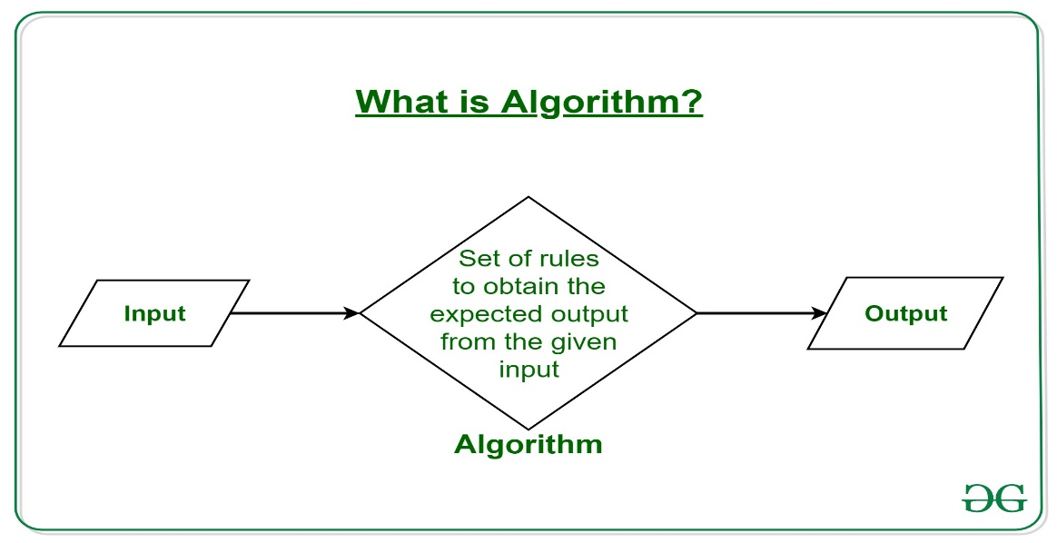
What is an algorithm?
An algorithm is any well-defined computational procedure that takes some value, or set of values, as input and produces some value, or set of values as output.
In other words it defines a step by step process to solve a particular problem.

Slide 4
Why study Algorithms?
By studying algorithms you will be able to find the best algorithm for you problem(as there exists multiple algorithms for a problem).
You can differentiate two or more algorithms on the basis of there efficiency , resource utilization , time to solve problem and accuracy.

Slide 5
Sorting
Sorting any sequence means to arrange the elements of that sequence according to some specific criterion.
For Example, the array arr[] = {5, 4, 2, 1, 3} after sorting in increasing order will be: arr[] = {1, 2, 3, 4, 5}. The same array after sorting in descending order will be: arr[] = {5, 4, 3, 2, 1}.
In-Place Sorting: An in-place sorting algorithm uses constant extra space for producing the output (modifies the given array only). It sorts the list only by modifying the order of the elements within the list.

Slide 6
Sorting Algorithms
1. Insertion Sort
2. Selection Sort
3. Bubble Sort
4. Heap Sort
5. Counting Sort
6. Quick Sort
7. Merge Sort

Slide 7
Insertion Sort
Insertion Sort is an In-Place sorting algorithm. This algorithm works in a similar way of sorting a deck of playing cards. The idea is to start iterating from the second element of array till last element and for every element insert at its correct position in the subarray before it. In the below image you can see, how the array [9, 7, 6, 15, 17, 5, 10,11] is being sorted in increasing order following the insertion sort algorithm.

Slide 8
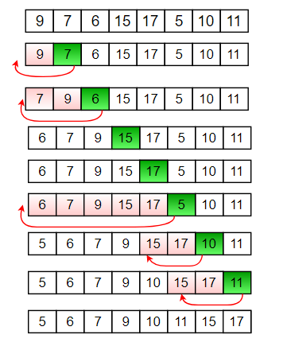
Algorithm:
Step 1: If the current element is 1st element of array, it is already sorted.
Step 2: Pick next element
Step 3: Compare the current element will all elements in the sorted sub-array before it.
Step 4: Shift all of the elements in the sub-array before the current element which are greater than the current element by one place and insert the current element at the new empty space.
Step 5: Repeat step 2-3 until the entire array is sorted.

Slide 9
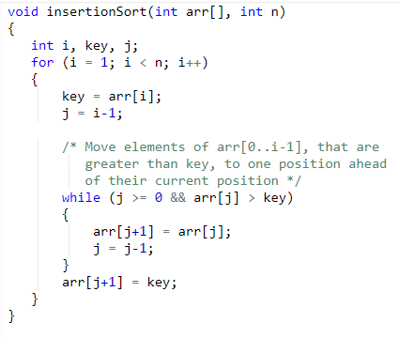
Insertion Sort Implementation
T(N)= O(N²)
S(N) = O(1)

Slide 10
Bubble Sort
Bubble Sort is also an in-place sorting algorithm. This is the simplest sorting algorithm and it works on the principle that:
In one iteration if we swap all adjacent elements of an array such that after swap the first element is less than the second element then at the end of the iteration, the first element of the array will be the minimum element.
Bubble-Sort algorithm simply repeats the above steps N-1 times, where N is the size of the array.

Slide 11
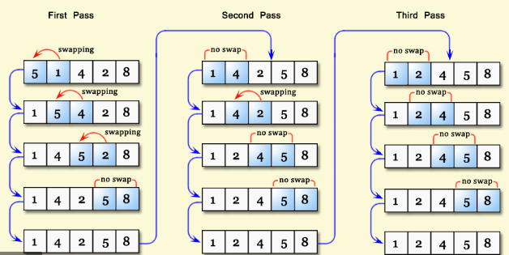
Algorithm:
Step1: Starting with the first element(index = 0), compare the current element with the next element of the array.
Step2: If the current element is greater than the next element of the array, swap them.
Step 3: If the current element is less than the next element, move to the next element.
Repeat Step 1.

Slide 12
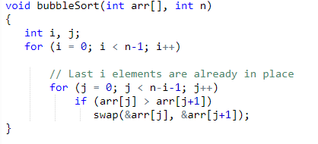
Bubble Sort Implementation
T(N)= O(N²)
S(N) = O(1)

Slide 13
Selection Sort
The selection sort algorithm sorts an array by repeatedly finding the minimum element (considering ascending order) from unsorted part and putting it at the beginning. The algorithm maintains two subarrays in a given array.
1. The subarray which is already sorted.
2. Remaining subarray which is unsorted.
In every iteration of selection sort, the minimum element (considering ascending order) from the unsorted subarray is picked and moved to the sorted subarray.

Slide 14
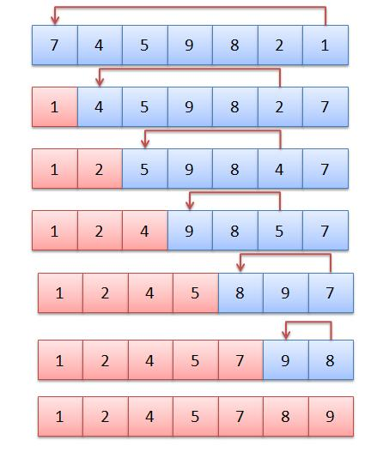
Algorithm:
Step 1: Starting from the first element, we search the smallest element in the array, and replace it with the element in the first position.
Step 2: We then move on to the second position, and look for smallest element present in the subarray, starting from index 1, till the last index.
Step 3: We replace the element at the second position in the original array, or we can say at the first position in the subarray, with the second smallest element.
Step 4: This is repeated, until the array is completely sorted.

Slide 15
Selection Sort Algorithm
Step 1: Starting from the first element, we search the smallest element in the array, and replace it with the element in the first position.
Step 2: We then move on to the second position, and look for smallest element present in the subarray, starting from index 1, till the last index.
Step 3: We replace the element at the second position in the original array, or we can say at the first position in the subarray, with the second smallest element.
Step 4: This is repeated, until the array is completely sorted.

Slide 16
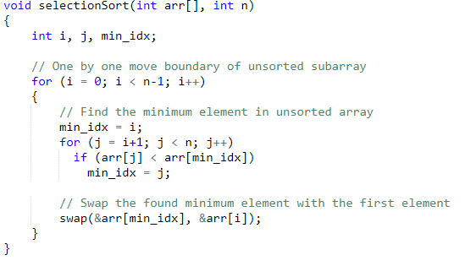
Selection Sort Implementation
T(N)= O(N²)
S(N) = O(1)

Slide 17
Heap Sort
Heap sort is a comparison based sorting technique based on Binary Heap data structure. It is similar to selection sort where we first find the maximum element and place the maximum element at the end. We repeat the same process for remaining elements.

Slide 18
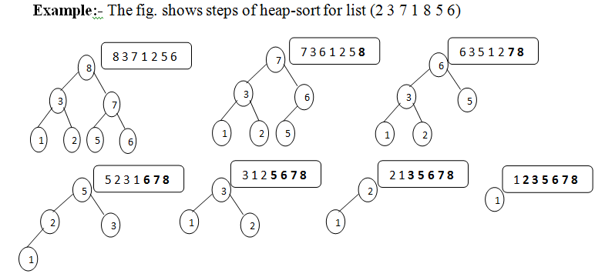
Example
Step 1: Build a max heap from the input data.
Step 2: At this point, the largest item is stored at the root of the heap. Replace it with the last item of the heap followed by reducing the size of heap by 1. Finally, heapify the root of tree.
Step 3: Repeat above steps while size of heap is greater than 1.

Slide 19
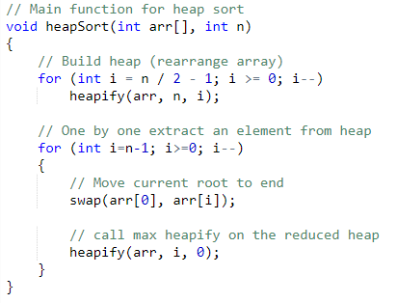
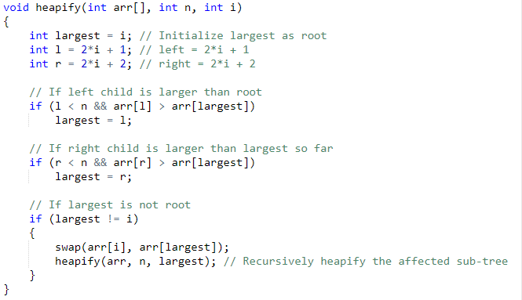
Heap Sort Implementation
Time complexity of heapify is O(LogN). So, T(N) of Heap Sort is O(NlogN)
S(N) = O(1)

Slide 20
Counting Sort
Counting sort is a sorting technique based on keys between a specific range.
It works by counting the number of objects having distinct key values.
Then doing some arithmetic to calculate the position of each object in the output sequence.

Slide 21
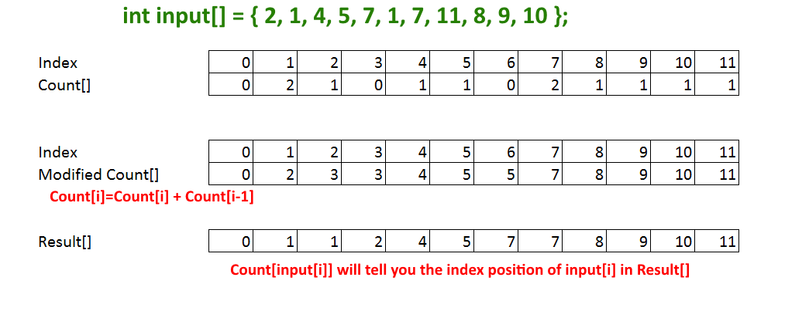
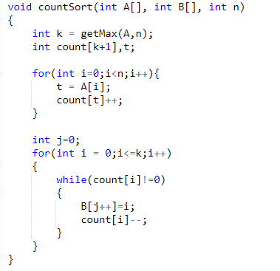

Example
T(N) : O(N + K)
S(N) : O(N + K)

Slide 22
Searching
Searching Algorithms are designed to check for an element or retrieve an element from any data structure where it is stored. Based on the type of search operation, these algorithms are generally classified into two categories:
1.Sequential Search: In this, the list or array is traversed sequentially and every element is checked. For example: Linear Search.
2.Interval Search: These algorithms are specifically designed for searching in sorted data-structures. These type of searching algorithms are much more efficient than Linear Search as they repeatedly target the center of the search structure and divide the search space in half. For Example: Binary Search.

Slide 23
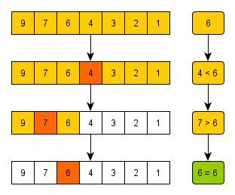
Binary Search
Search a sorted array by repeatedly dividing the search interval in half.
Begin with an interval covering the whole array.
If the value of the search key is less than the item in the middle of the interval, narrow the interval to the lower half.
Otherwise narrow it to the upper half. Repeatedly check until the value is found or the interval is empty.

Slide 24
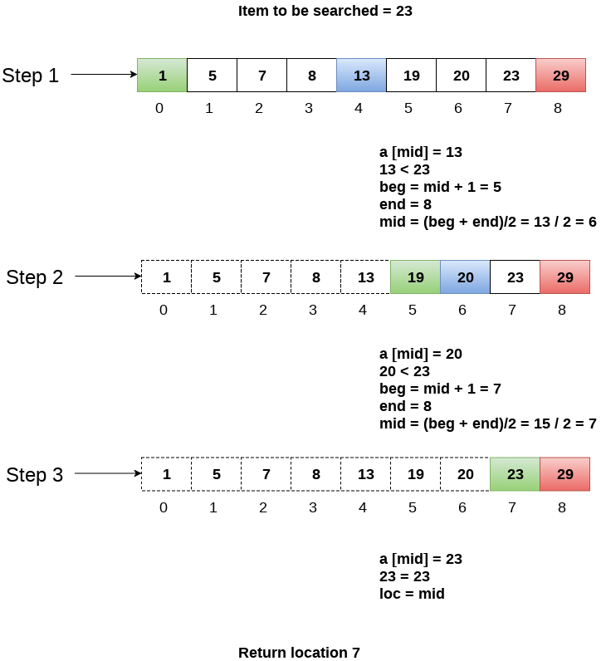
Example:

Slide 25
Problem 1:
Given an array of integers. All numbers occur twice except one number which occurs once. Find the number in O(n) time & constant extra space.
Input: ar[] = {7, 3, 5, 4, 5, 3, 4}
Output: 7

Slide 26
Solutions : Brute Force
Brute force:
Check every element if it appears once or not. Once an element with single occurrence is found, return it. Time complexity of this solution is O(n²).

Slide 27
Solutions: Hashing
1) Traverse all elements and put them in a hash table. Element is used as key and count of occurrences is used as value in hash table.
2) Traverse the array again and print the element with count 1 in hash table.
This solution works in O(n) time, but requires extra space.

Slide 28
Solution: XOR trick
a) XOR of a number with itself is 0. b) XOR of a number with 0 is number itself.
Example:
Array : {7,3,5,4,5,3,4}
res : 7
Since XOR is associative and commutative, above expression can be written as:
res = 7 ^ 3 ^ 5 ^ 4 ^ 5 ^ 3 ^ 4
res = 7 ^ (3 ^ 3) ^ (4 ^ 4) ^ (5 ^ 5)
= 7 ^ 0 ^ 0 ^ 0
= 7 ^ 0
= 7

Slide 29
Problem 2:
Statement : You are given an array of 0s and 1s in random order. Segregate 0s on left side and 1s on right side of the array. Traverse array only once.
Input array = [0, 1, 0, 1, 0, 0, 1, 1, 1, 0]
Output array = [0, 0, 0, 0, 0, 1, 1, 1, 1, 1]

Slide 30
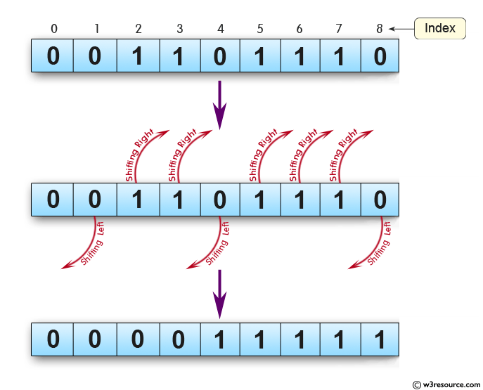
Optimised way: Two pointer approach
1. Take two pointer ptr0(for element 0) starting from beginning (index = 0) and ptr1(for element 1) starting from end (index = array.length-1).
Initialize ptr0= 0 and ptr1= array.length-1
2. It is intended to Put 1 to the right side of the array. Once it is done, then 0 will definitely towards left side of array.

Slide 31
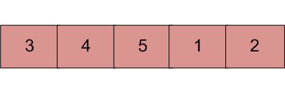
Problem 3:
An element in a sorted array can be found in O(log n) time via binary search. But suppose we rotate an ascending order sorted array at some pivot unknown to you beforehand. So for instance, 1 2 3 4 5 might become 3 4 5 1 2. Devise a way to find an element in the rotated array in O(log n) time.
Example :
Input : arr[] = {5, 6, 7, 8, 9, 10, 1, 2, 3};
key = 3
Output : Found at index 8
Input : arr[] = {5, 6, 7, 8, 9, 10, 1, 2, 3};
key = 30
Output : Not found
Input : arr[] = {30, 40, 50, 10, 20}
key = 10
Output : Found at index 3

Slide 32
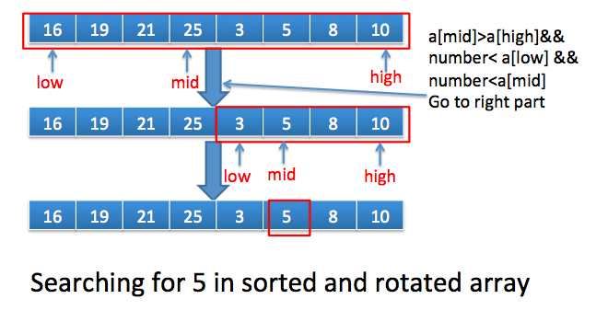
Algorithm:
Example: {16,19,21,25,3,5,8,10};
1) Find middle point mid = (l + h)/2
2) If key is present at middle point, return mid.
3) Else If arr[l..mid] is sorted
a) If key to be searched lies in range from arr[l]
to arr[mid], recur for arr[l..mid].
b) Else recur for arr[mid+1..h]
4) Else (arr[mid+1..h] must be sorted)
a) If key to be searched lies in range from arr[mid+1]
to arr[h], recur for arr[mid+1..h].
b) Else recur for arr[l..mid]
16 19 21 25 27 3 5 8

Slide 33
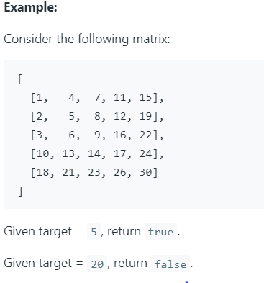
Problem 4:
Statement : Write an efficient algorithm that searches for a value in an m x n matrix. This matrix has the following properties:
Integers in each row are sorted in ascending from left to right.
Integers in each column are sorted in ascending from top to bottom.

Slide 34
Brute Force:
Search each element of the matrix.
T(N) = O(m*n)
S(N) = O(1) no extra space required

Slide 35
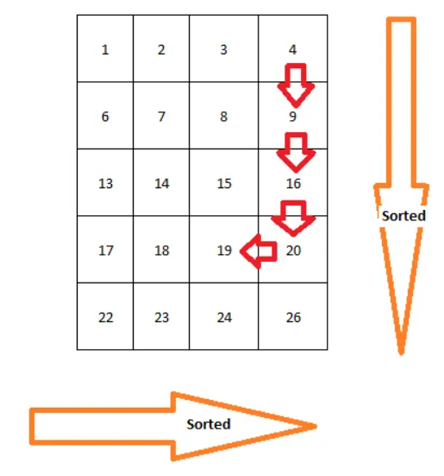
Optimized
We start search the matrix from top right corner
initialize the current position to top right corner
if the target is greater than the value in current position, then the target can not be in entire row of current position because the row is sorted,
if the target is less than the value in current position, then the target can not in the entire column because the column is sorted too.
We can rule out one row or one column each time, so the time complexity is O(m+n).

Slide 36
Exercises :
1. Given an array A[] consisting 0s, 1s and 2s. The task is to write a function that sorts the given array. The functions should put all 0s first, then all 1s and all 2s in last. This should be done in time complexity O(N) and without using extra space.
2.Implement Binary Search Algorithm iteratively.
3. Given a sorted array in which all elements appear twice (one after one) and one element appears only once. Find that element in O(log n) complexity.

Slide 37
Resources
Learn Algorithms with Dance : https://www.youtube.com/user/AlgoRythmics
Visualization of Sorting Algorithms: https://visualgo.net/en/sorting

